Slide 1

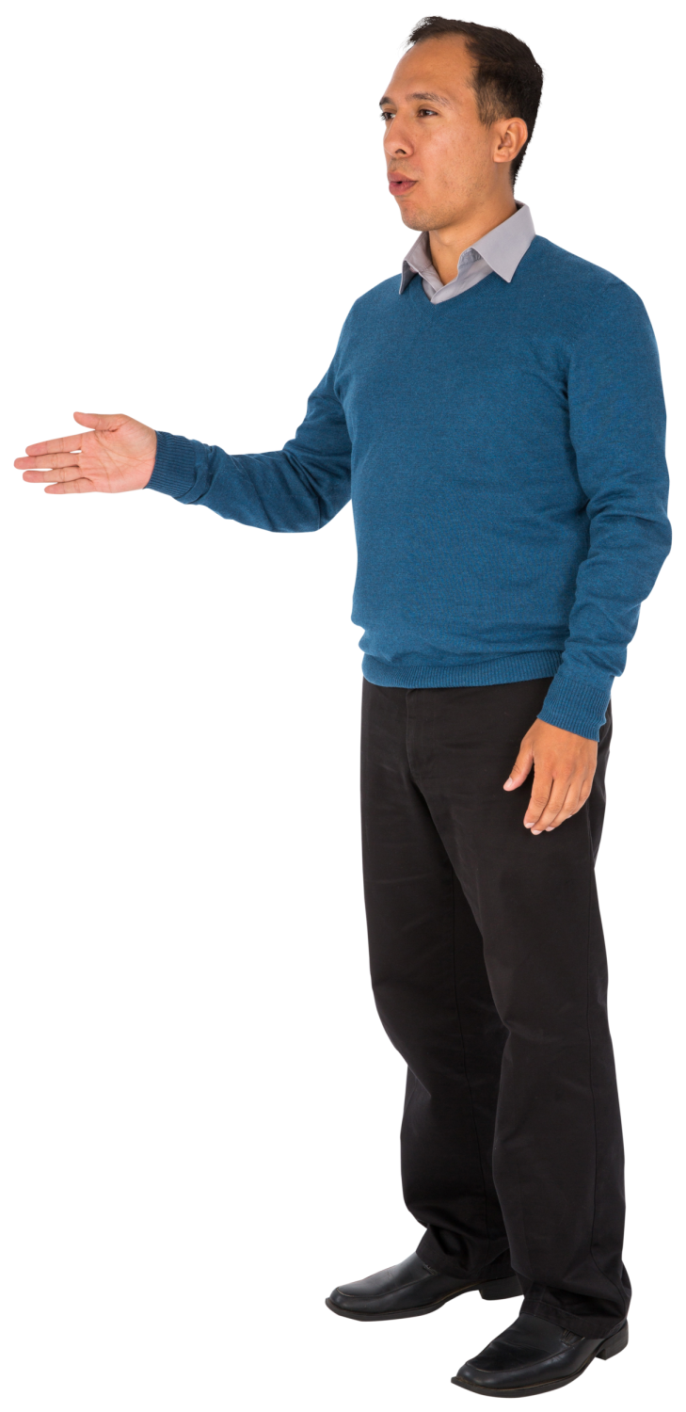
Think of a time when you were given negative feedback
What happened?
Did you expect it?
How did you feel?
Was it provided in the best way? Why or why not?
Think about this for a minute, then click here to continue.

Slide 2
  Situation:
  You just observed a peer teaching a class of teenagers. She has limited experience teaching adults, and almost no experience teaching teenagers.
  The class had good content and examples but it was very teacher-centered and without much participant interaction. Most of the participants ended up disengaged and playing on their phones. She asks what you think.
Continue

Slide 3


How do you respond?
Yeah, let’s talk about it! Before I told you what I saw, why don’t you tell me how you felt about it?
So, What did you think? How did it go?
Well, the content was good and age-appropriate, but you could improve some things about delivery.

Slide 4
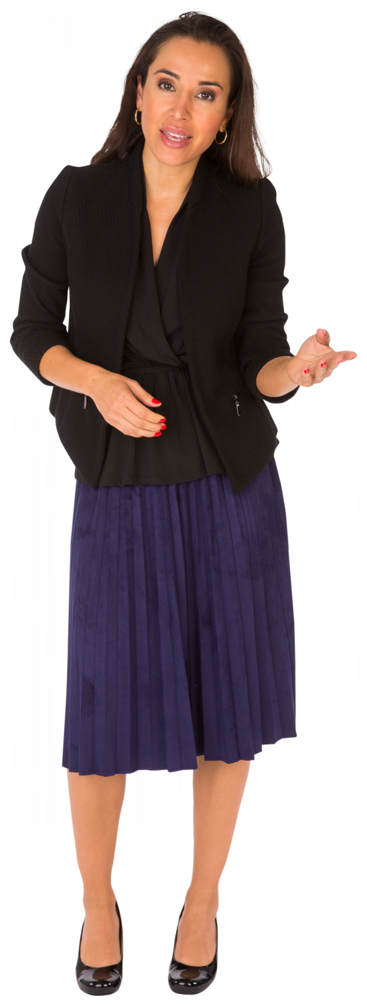
Asking her to first share her impressions is a great way to open the conversation.
Now what should you say?
Well, you spent about 5 minutes on the warm-up, and all the participants were talking. Then it was followed by a 18-minute lecture. Only you were talking during that time.
Well, I felt like they were really bored and there wasn’t much energy. What do you think?
The students were bored during your lecture. It was too long. It is better if you engage them and make it less passive.

Slide 5

Starting the conversation with critical feedback may not have been the best choice, but let’s see what happens next.
Now what should you say?
Why do you think it wasn’t interesting? What did you notice in the class that makes you think this?
Oh. Well, I mean, it could have been more interesting. I am not feeling very good about it.
You are right. The students weren’t paying much attention. You lectured for too long and students were bored and on their phones.

Slide 6
Great work!
You stated what you saw and were descriptive instead of providing criticism.
Reflecting this back to her made her see a potential problem (the length of time she spent lecturing) and now she is open and ready to brainstorm solutions to improve next time.
Oh wow, that lasted that long? I thought that was just a 5-minute mini-lecture! I guess I have to rethink that and break it up with some interaction. What ideas do you have?
End of scenario!
Click here to restart it.

Slide 7
Good save!
It may have been better to start off by asking her what she thought was going on in the lesson, instead of giving her criticism up front. But you realized that and helped her come to the right conclusions on her own.
Well, I think my lecture took longer than I thought, so maybe it was me talking for too long.
End of scenario!
Click here to restart it.

Slide 8
Uh oh!
That approach didn’t work so well, and now she feels deflated and frustrated.
Let’s go back and try another approach.
They really were. I am just not good at this at all. Maybe I am in the wrong position.
Go back and try again.

Slide 9
Technical Tips
Use a rectangle shape for a button, or scroll down to the last objects under Insert < Shapes to use the built-in action buttons.
Right click on the rectangle (or any object), select Link, and then select Place in this document to link the object to another slide when you click it.
Go into the Slide Show tab and then into Set Up Slide Show. Toggle Browsed at a Kiosk so that users can’t use arrow or clicks to go to the next slide. This will force them to use your button.

